Slide 1
Object Oriented Programming
Inheritance
(continued)

Slide 2
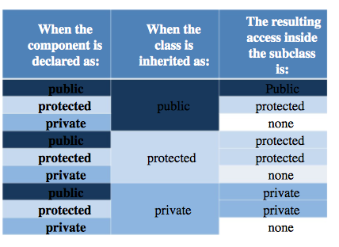
Inheritance types
Accessibility:
Private < Protected < Public
Take a look at the table here →
It gathers all of the possible combinations of the component declaration and inheritance model, presenting the resulting access to the components when the subclass is completely defined.
It reads in the following way (take a look at the first row): if a component is declared as public and its class is inherited as public, the resulting access is public.
Familiarize yourself with the table – it’s a basic tool to resolve all the issues regarding the inheritance of the class components.

Slide 3
Redefining (Overriding) Member Functions of the Base Class
To redefine (override) a public member function of a base class
Corresponding function in the derived class must have the same name, number, and types of parameters. Redefined
If the function has a different signature, this would be function overloading.

Slide 4
Redefining (Overriding) Member Functions of the Base Class (continued)
If derived class overrides a public member function of the base class, then to call the base class function, specify:
Name of the base class
Scope resolution operator (::)
Function name with the appropriate parameter list

Slide 5
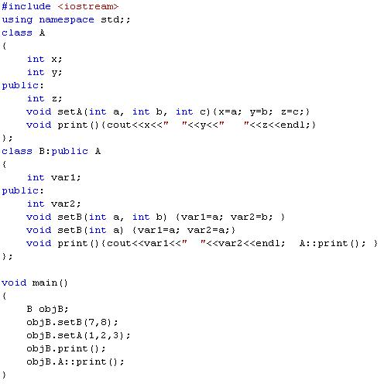
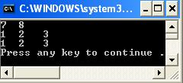
var1
var2
z
x
y
print
setB
A::print
setA

Slide 6
Constructors of Derived and Base Classes
Derived class constructor cannot directly access private members of the base class
Derived class can directly initialize only public member variables of the base class
When a derived object is declared
It must execute one of the base class constructors
Call to base class constructor is specified in heading of derived class constructor definition

Slide 7
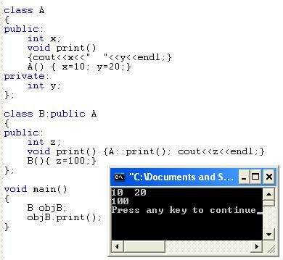
Example

Slide 8
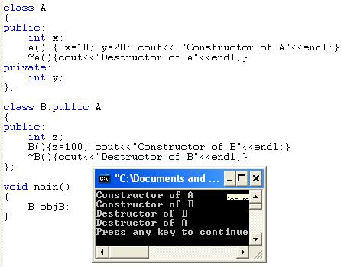
Example

Slide 9
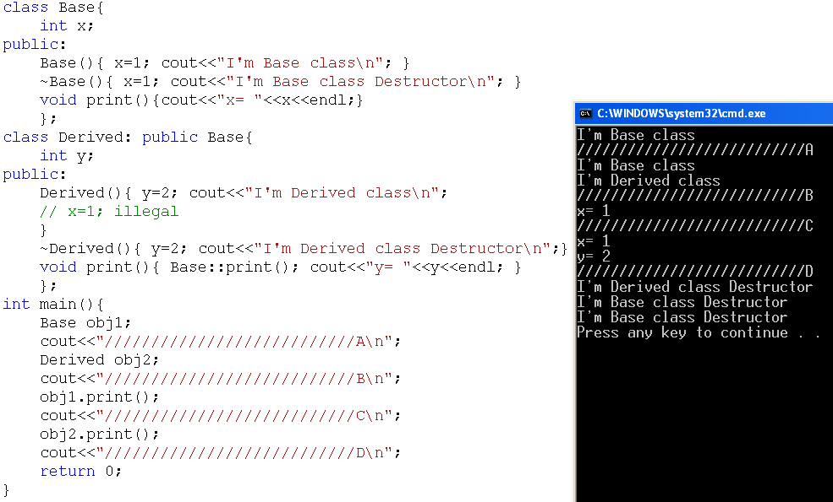
Example
9

Slide 10
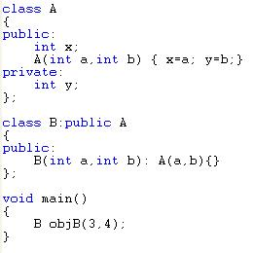
Initialization List and Inheritance
objB
A
3
x
4
y
Initialization list goes with constructor of derived class and uses class name to pass parameters to base class constructor.

Slide 11
Protected Members of a Class
Private members of a class cannot be directly accessed outside the class
For a base class to give derived class access to a private member
Declare that member as protected
The accessibility of a protected member of a class is in between public and private
A derived class can directly access the protected member of the base class

Slide 12
Inheritance as public, protected, or private
If memberAccessSpecifier is public:
public members of A are public members of B and can be directly accessed in class B
protected members of A are protected members of B and can be directly accessed by member functions (and friend functions) of B
private members of A are hidden in B and can be accessed by member functions of B through public or protected members of A

Slide 13
Inheritance as public, protected, or private (continued)
If memberAccessSpecifier is protected:
public members of A are protected members of B and can be accessed by the member functions (and friend functions) of B
protected members of A are protected members of B and can be accessed by the member functions (and friend functions) of B
private members of A are hidden in B and can be accessed by member functions of B through public or protected members of A

Slide 14
Inheritance as public, protected, or private (continued)
If memberAccessSpecifier is private:
public members of A are private members of B and can be accessed by member functions of B
protected members of A are private members of B and can be accessed by member functions (and friend functions) of B
private members of A are hidden in B and can be accessed by member functions of B through public/protected members of A

Slide 15
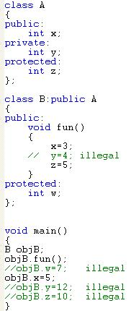
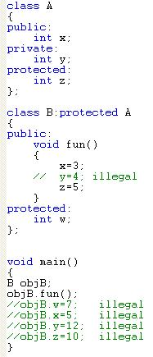
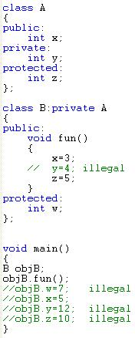

Slide 16
6.1.8 Defining a simple subclass (8)
We’ll finish our current topic with a very simple example demonstrating multi-inheritance. We need to emphasize that using this technique is commonly recognized as error-prone and obfuscating class hierarchy.
Any solution that avoids multi-inheritance is generally better and in fact many contemporary object programming languages don’t offer multi-inheritance at all. We think it’s a good argument to consider when you’re making design assumptions.

Slide 17
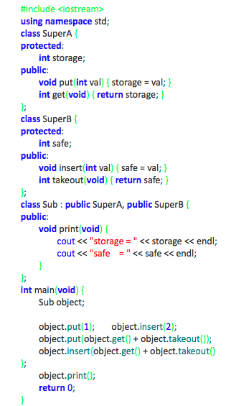
6.1.8 Defining a simple subclass (8) cont’d
This example should be clear (we hope).
The program will produce the following output:
storage = 3
safe = 5

Slide 18
Summary
Inheritance and composition are meaningful ways to relate two or more classes
Inheritance is an “is-a” relation
Single inheritance: a derived class is derived from one class, called the base class
Multiple inheritance: a derived class is derived from more than one base class
Composition and aggregation are “has-a” relation

Slide 19
Summary (continued)
Private members of a base class are private to the base class
Public members of a base class can be inherited either as public or private
Derived class can redefine function members of a base class
Redefinition applies only to objects of derived class

Slide 20
Summary (continued)
A call to a base class constructor (with parameters) is specified in the heading of the definition of the derived class constructor
When initializing object of a derived class, the base class constructor is executed first
In composition
Class member is an object of another class
Call to constructor of member objects is specified in heading of the definition of class’s constructor

Slide 21
Examples on composition and inheritence

Slide 22
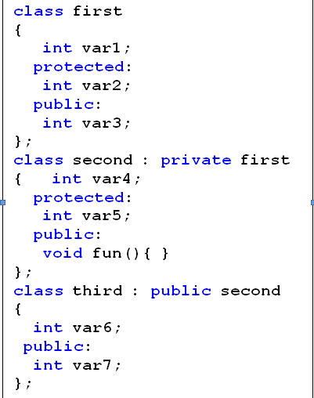
Answer the following questions based on the classes’ definitions shown next.

Slide 23
Output Questions

Slide 24
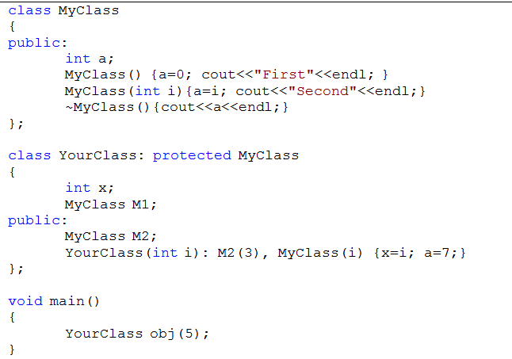


Slide 25
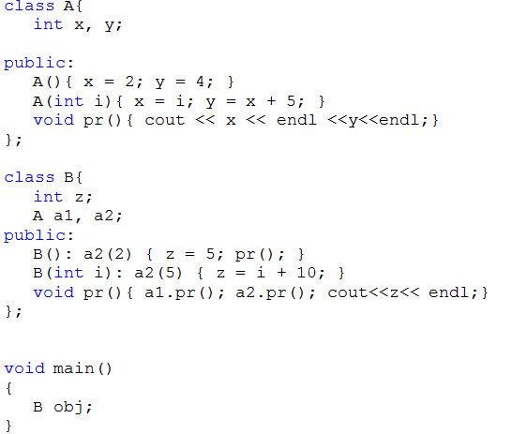


Slide 26
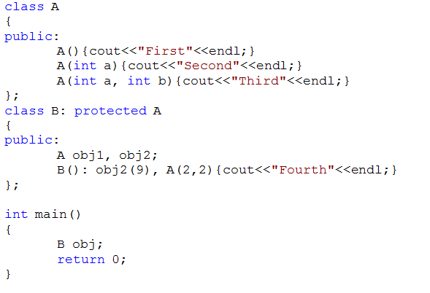


Slide 27
Writing code

Slide 28
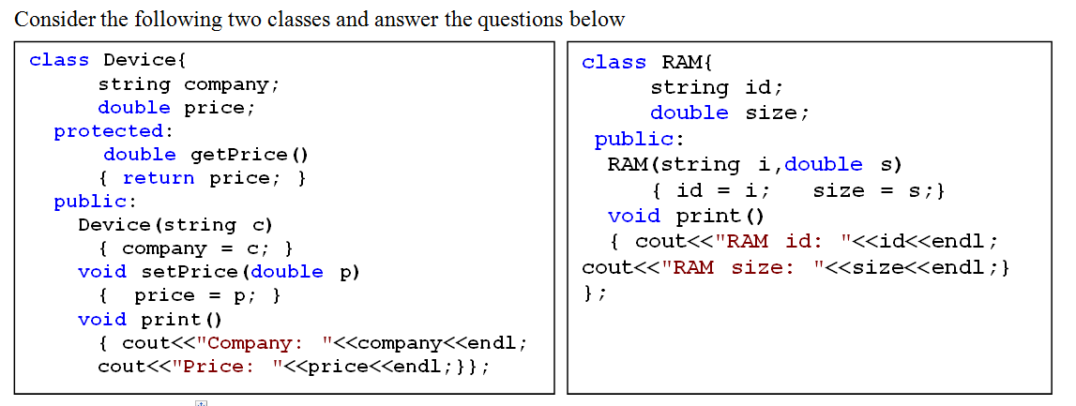

Slide 29
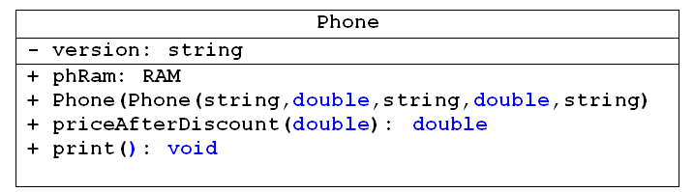
1) Write the header (the definition) of the new class Phone which publically inherits the properties of the class Device with the following additional members as shown in the below UML class diagram. (Don't write the implementation of the member functions inside the header)

Slide 30
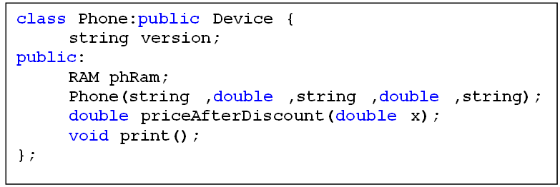

Slide 31
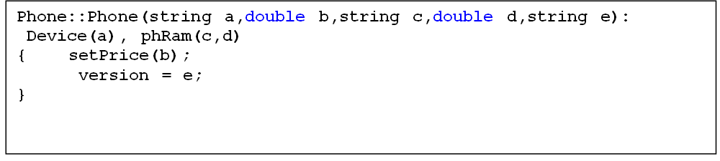
2) Write the implementation of the Constructor function (outside the class) that takes five parameters to set the company and the price for the Device, the id and the size for the phRam and the version for the Phone.

Slide 32
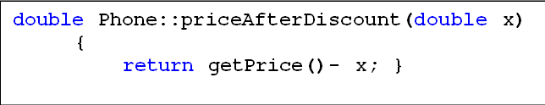
3) Write the implementation of priceAfterDiscount function that receives one double value which represents the discount for the phone and return the price after the discount.

Slide 33
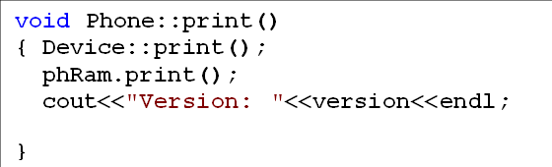
4) Write the implementation of the print function (outside the class) to print the company and the price for the Device, the id and the size for the phRam and the version for the Phone.

